Slide 1

Sales Funnel Analysis for Hostel Chain
Pintu kumar Kushwaha

Slide 2
Agenda
1
2
3
4
5
Introduction
Sales Funnel Analysis
Leads Analysis
Timeline
Summary

Slide 3

Introduction
Strent AH Pvt Limited (SAPL) has recently launched student hostels across India, providing flexible room rentals to university students and exam aspirants through their app and website.

Slide 4
Data Analysis Findings
Lead Sources:
Low Contact Rate:
Hot Leads:
Leads were generated from various sources, including landing pages, social media, and organic channels. However, conversion rates varied significantly among these sources.
A significant portion of leads was not contacted by the customer care team within the specified time frame after lead creation.
Analysis indicated that a subset of leads exhibited behavior suggesting a higher likelihood of conversion, termed "hot leads.

Slide 5
Project Approach
1. Understanding SAPL's Business Process
Begin by thoroughly understanding the student accommodation business process of Strent AH Pvt Limited (SAPL). This includes understanding how leads are generated, qualified, and converted into customers.
2. Data Collection and Preparation
Gather relevant datasets, including lead data, city data, lead status, and hostel information. Ensure the data is comprehensive and up-to-date.
3. Data Processing and Cleaning
Use Python (Jupyter Notebook) to merge datasets and perform data cleaning. Address missing values, inconsistencies, and errors in the data.
4. Exploratory Data Analysis (EDA)
Conduct exploratory data analysis to gain insights into the dataset. Calculate key statistics, visualize distributions, and identify patterns.
5. Feature Engineering
Create relevant features that can aid in the analysis, such as lead conversion rates, lead progression stages, and lead distribution by city.
6. Data Visualization
Utilize Tableau to create visualizations that help in understanding lead acquisition and conversion processes.
7. Lead Acquisition Stage Analysis
Analyze each stage of the lead acquisition process, from pre-verified to onboarding. Identify bottlenecks, drop-offs, and areas for improvement.
8. Key Insights and Findings
Summarize key findings from the analysis. Highlight factors affecting lead conversion rates and identify potential strategies for improvement.
9. Recommendations
Provide actionable recommendations to SAPL based on the analysis. This may include suggestions for improving lead qualification, customer care interactions, property visits, and agreement processes.
10. Documentation
Document the entire project, including data sources, data cleaning steps, analysis methodology, and code used for data processing and visualization.
11. Final Presentation
Deliver the final presentation to SAPL's leadership, addressing any questions or clarifications.
12. Project Closure
Ensure that all project deliverables are met, and SAPL is satisfied with the analysis and recommendations.

Slide 6
Introduction
Despite witnessing a surge in web page visits and mobile app usage during the admission season, SAPL faced a challenging issue - a low conversion rate of approximately 13% for leads generated.
This report documents the project undertaken to investigate and address the factors contributing to the significantly low lead conversion rate.
The primary focus was on analyzing the stages of student acquisition, with special attention to the lower percentage of calls made by the customer care team, a key area of concern.
This sales funnel analysis provides insights into the performance of a hostel booking platform.
The analysis looks at the number of leads generated, the conversion rates at each stage of the funnel, and the regional variations in demand.
The analysis also highlights the regional variations in hostel demand.
The lead trend and seasonal patterns highlight the need for strategic lead management and targeted marketing efforts.

Slide 7
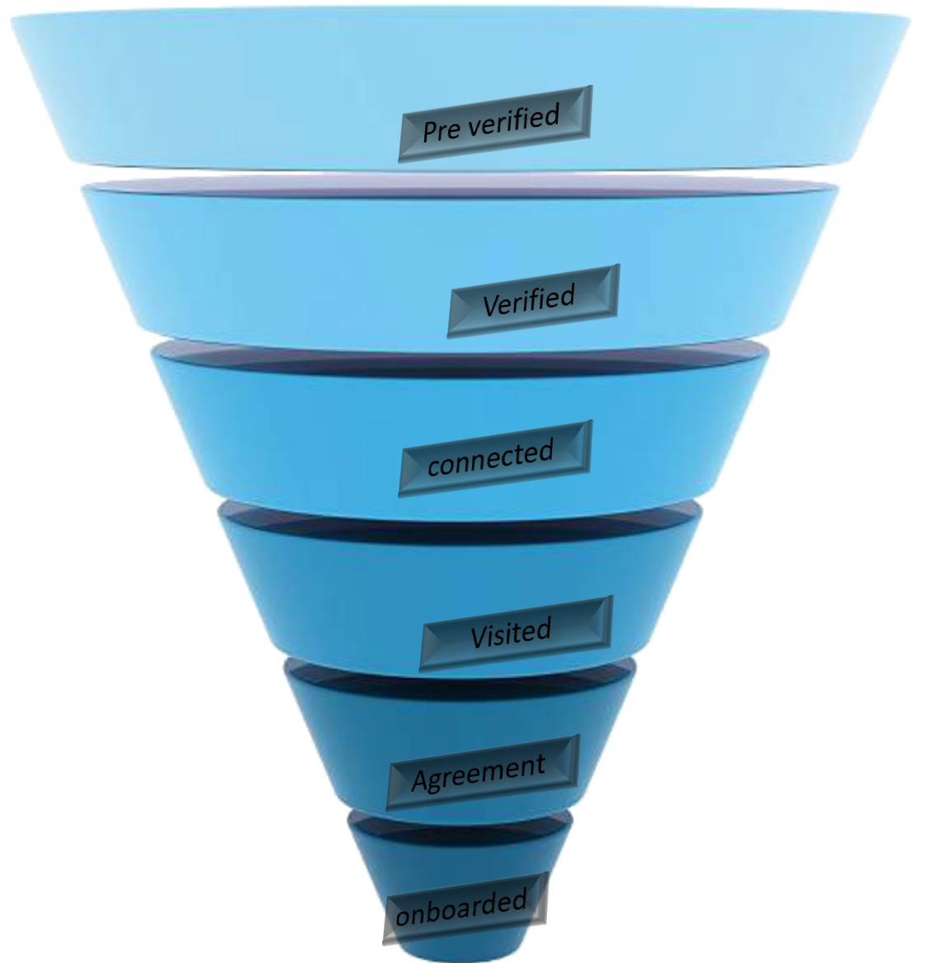
Sales Funnel Analysis
Low conversion rate.

Slide 8
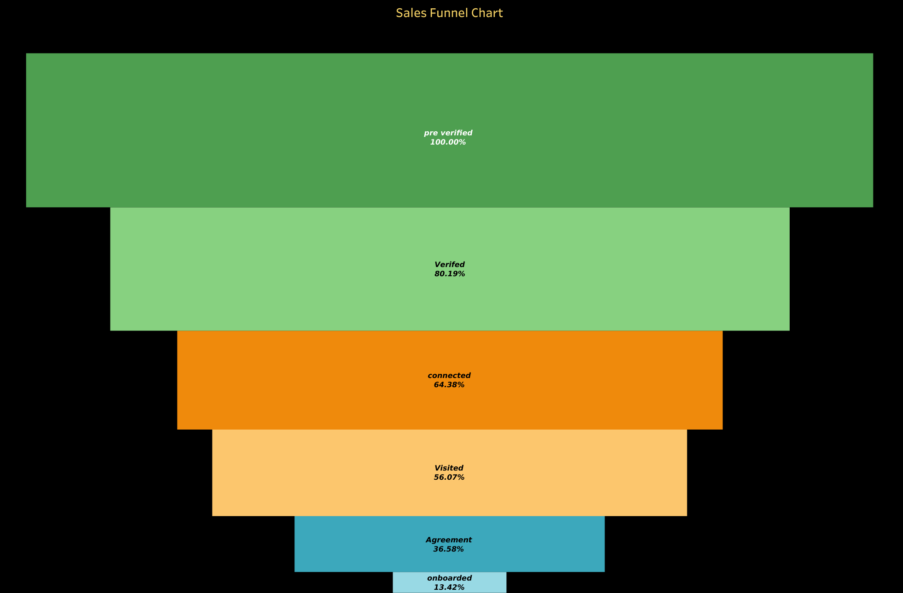
Sales Funnel chart
Pre-Verified: 626 leads, covering 100% of the total distinct lead count
Verified: 502 leads, constituting 80.19% of the total distinct lead count.
Connected: 403 leads, comprising 64.38% of the total distinct lead count.
Visited: 351 leads, representing 56.07% of the total distinct lead count.
Agreement: 229 leads, making up 36.58% of the total distinct lead count.
Onboarded: 84 leads, accounting for 13.42% of the total distinct lead count.

Slide 9
Sales Funnel Analysis
Onboarded (84 Leads, 13.42% of Total)
These are the success stories, where 84 leads have successfully transitioned from showing initial interest to becoming valued customers. They represent the accomplishment of the conversion process.
Agreement (229 Leads, 36.58% of Total)
The 'Agreement' stage is a significant milestone, with 229 leads agreeing to move forward. This stage signifies a crucial step towards conversion as terms and conditions are discussed and documented.
Visited (351 Leads, 56.07% of Total)
The 'Visited' stage shows a substantial number of leads, with 351 individuals taking the initiative to physically explore their potential accommodations. It's a testament to the effectiveness of property visits in the conversion process.
Connected (403 Leads, 64.38% of Total)
A significant majority, 403 leads, have reached the 'Connected' stage. This stage represents active engagement and communication between leads and our customer care team, a key factor in conversion.
Verified (502 Leads, 80.19% of Total)
The 'Verified' stage boasts 502 leads, indicating the establishment of trust and authenticity through email and mobile number verification. Verified leads are more likely to complete the conversion journey.
Pre-Verified (626 Leads, 100% of Total)
At the starting point, we have 626 'Pre-Verified' leads. They are the foundation of our conversion process, signifying initial interest and engagement.

Slide 10
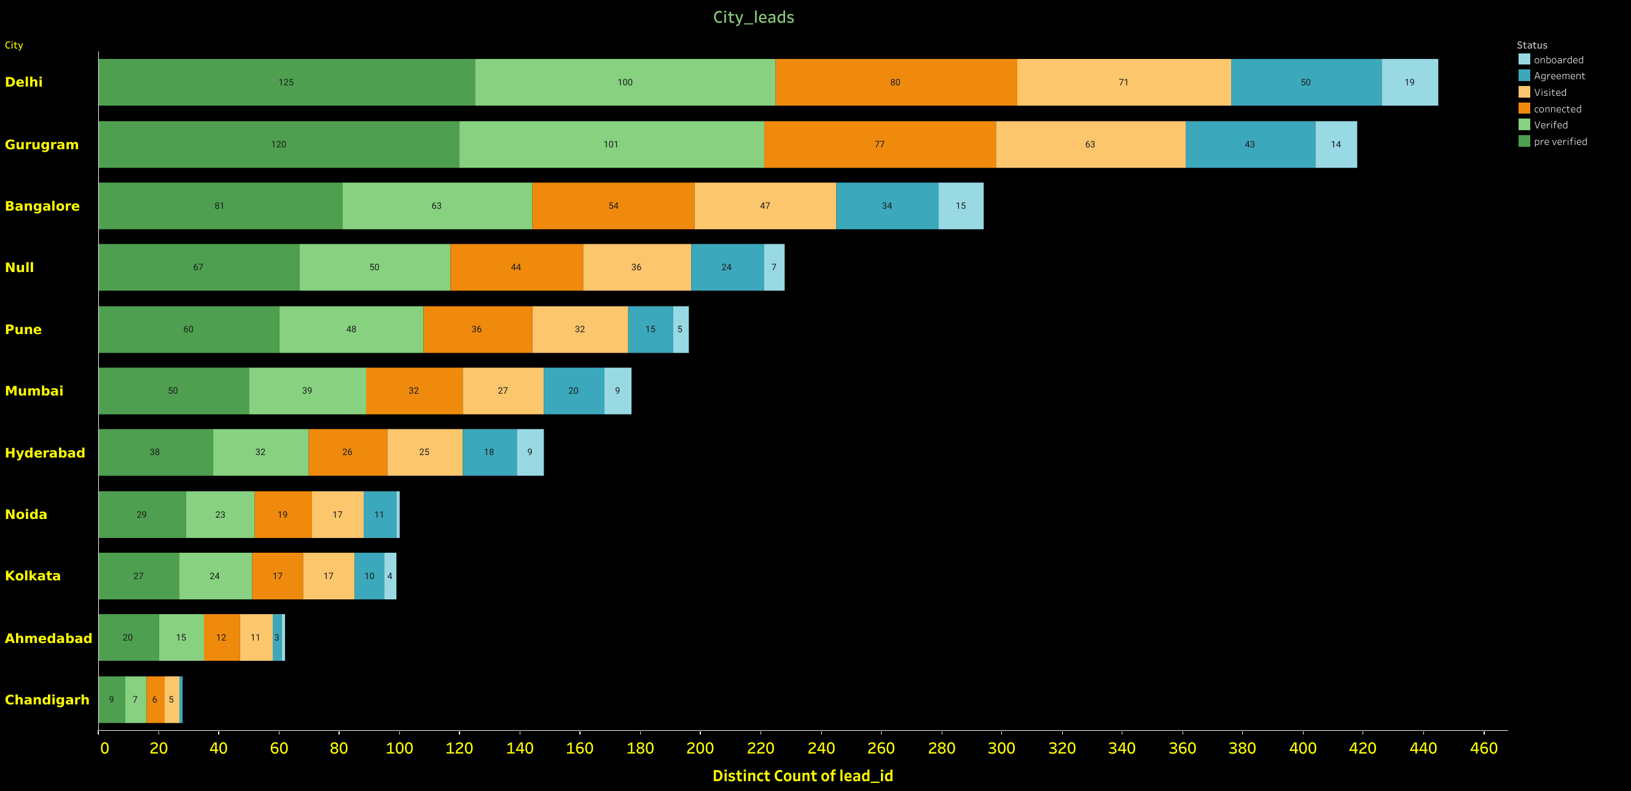
Leads Across Cities

Slide 11
Leads in different city
Conversion Progress in Different Cities:
The dataset provides insights into the progression of leads through various stages in different cities.
It shows how leads move from the initial "Pre-Verified" stage to ultimately becoming "Onboarded" in different cities.
Lead Count Variation:
Cities like Delhi and Gurugram have a high number of leads across all stages.
Kolkata and Noida have relatively fewer leads in the pipeline.
Lead Verification:
Most cities have a substantial number of "Pre-Verified" leads, indicating initial interest.
"Verified" leads are a step further, showing validated contact details.
Lead Engagement:
The "Connected" stage indicates active engagement between leads and the company's customer care team.
It's followed by the "Visited" stage, where leads physically explore the accommodation options.
Agreement and Onboarding:
"Agreement" shows leads are ready to commit, and "Onboarded" indicates successful conversions.
Delhi, Gurugram, and Bangalore lead in terms of successful agreements and onboardings.
Conversion Rates:
The conversion rates vary between stages and cities.
For example, Delhi has a high conversion rate from "Visited" to "Agreement."
Opportunities for Improvement:
Cities like Kolkata and Noida have room for improvement in terms of lead progression.
Identifying and addressing bottlenecks in these cities can lead to increased conversions.
City-Specific Strategies:
The data suggests that each city may require a tailored approach to maximize lead conversion.
Understanding the unique challenges in each location can help develop effective strategies.
Overall Insights:
This data provides valuable insights into how leads progress through the conversion funnel.
It can guide decision-making and resource allocation to enhance conversion rates in different cities.

Slide 12
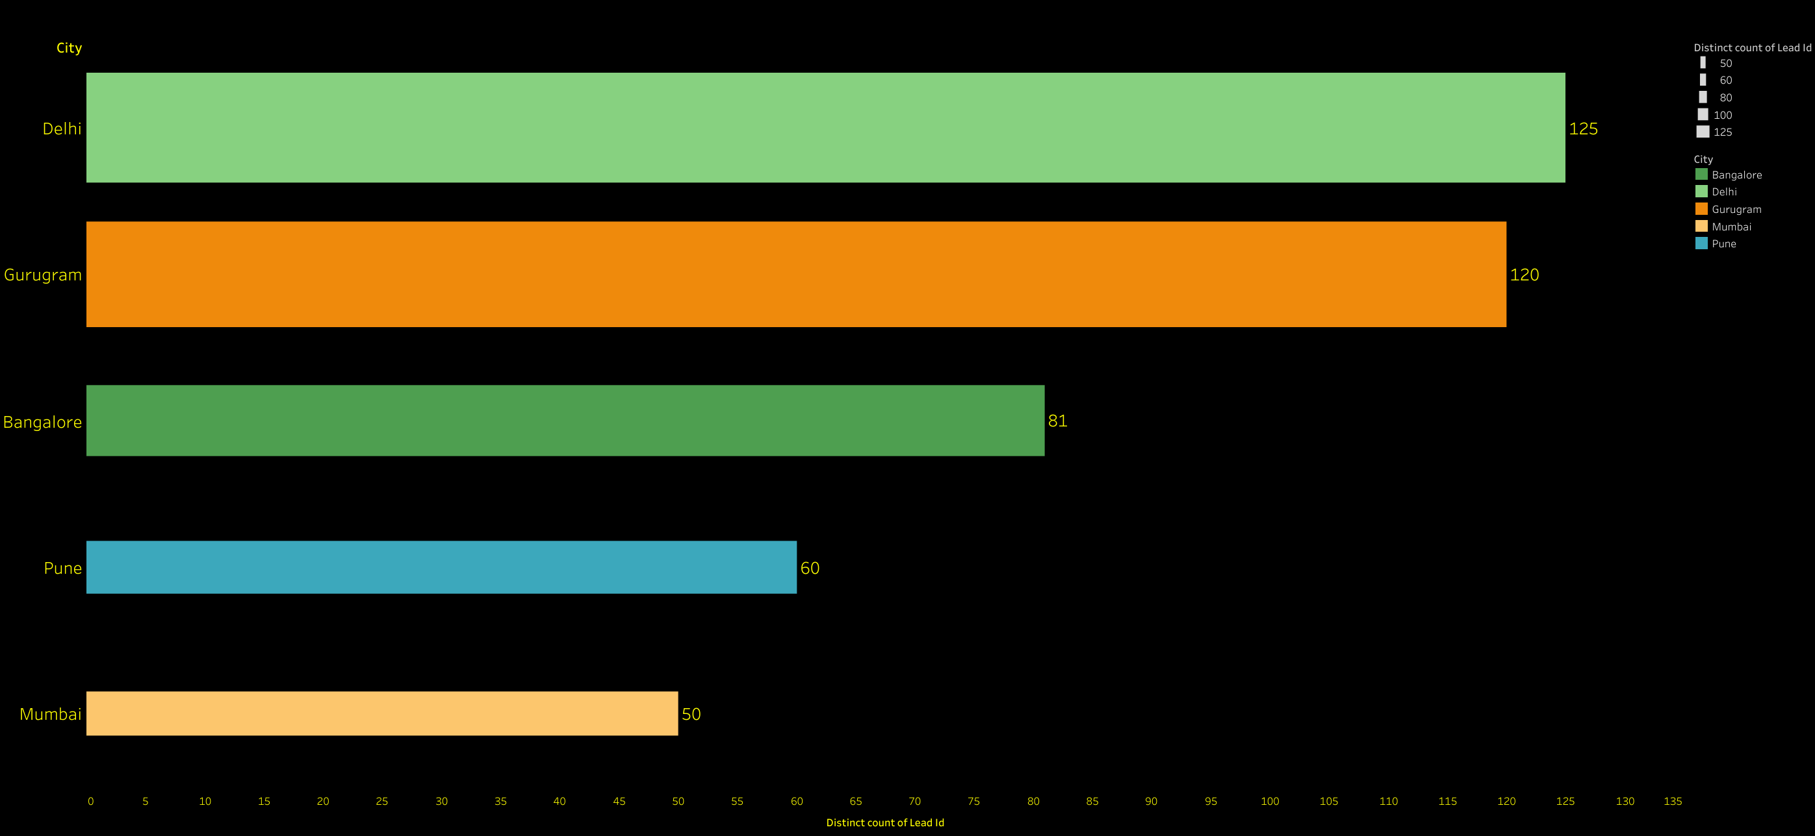
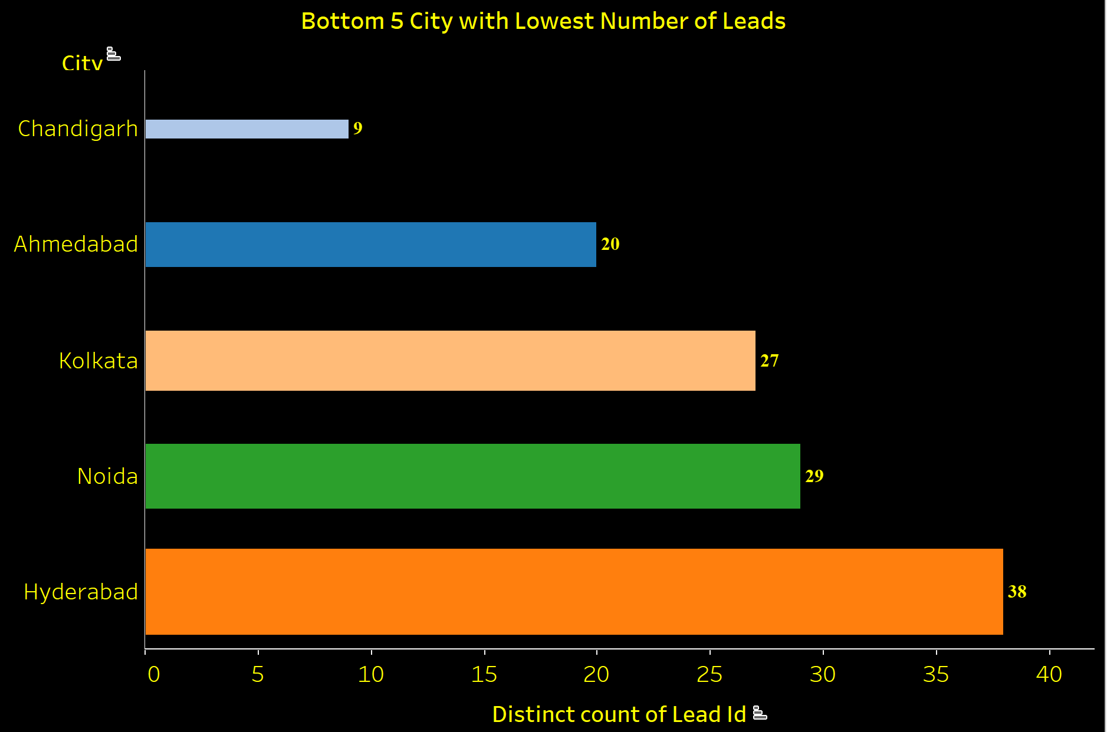
Top & Bottom 5 city by Lead

Slide 13
Top 5 city by Lead
City-wise Distribution of Leads:
Delhi had the highest number of leads with 125.
Gurugram closely followed with 120 leads.
Bangalore secured the third position with 81 leads.
Pune and Mumbai had 60 and 50 leads, respectively.
A Closer Look at Other Cities:
Hyderabad had 38 leads.
Noida gathered 29 leads.
Kolkata generated 27 leads.
Ahmedabad contributed 20 leads.
Chandigarh produced 9 leads.
Challenges in Conversion:
The drop in lead numbers from the "Connected" stage to the "Visited" stage suggests that some leads might lose interest after initial contact.
Further, there is a decline in leads from the "Visited" stage to the "Agreement" stage, indicating challenges in finalizing agreements.
"Onboarded" stage has the fewest leads, implying that the conversion process requires optimization.
Regional Variations:
Different cities exhibit varying lead counts at each stage, emphasizing regional differences in lead conversion.
For instance, Delhi has the highest number of leads across all stages, while Chandigarh has the fewest leads at each stage.

Slide 14
City insights
City-Specific Insights:
Gurugram, despite having fewer leads than Delhi and Bangalore initially, has a higher number of leads in the "Connected" and "Visited" stages, showcasing efficient lead progression.
Mumbai and Pune have a balanced distribution of leads across the stages, which indicates a steady conversion process.
Pre-Verified Leads:
"Pre-Verified" is the most populated stage across all cities, suggesting a high initial interest in accommodation.
However, the challenge lies in maintaining this interest and guiding leads through subsequent stages.
Opportunities for Improvement:
There is an opportunity to optimize the conversion process, especially in the transition from the "Visited" to the "Agreement" stage and further to the "Onboarded" stage.
Understanding the specific challenges faced in different cities can lead to targeted strategies for improvement.
In summary, It highlights areas for improvement in the conversion process and underscores the importance of region-specific strategies to enhance lead conversion and customer satisfaction.

Slide 15
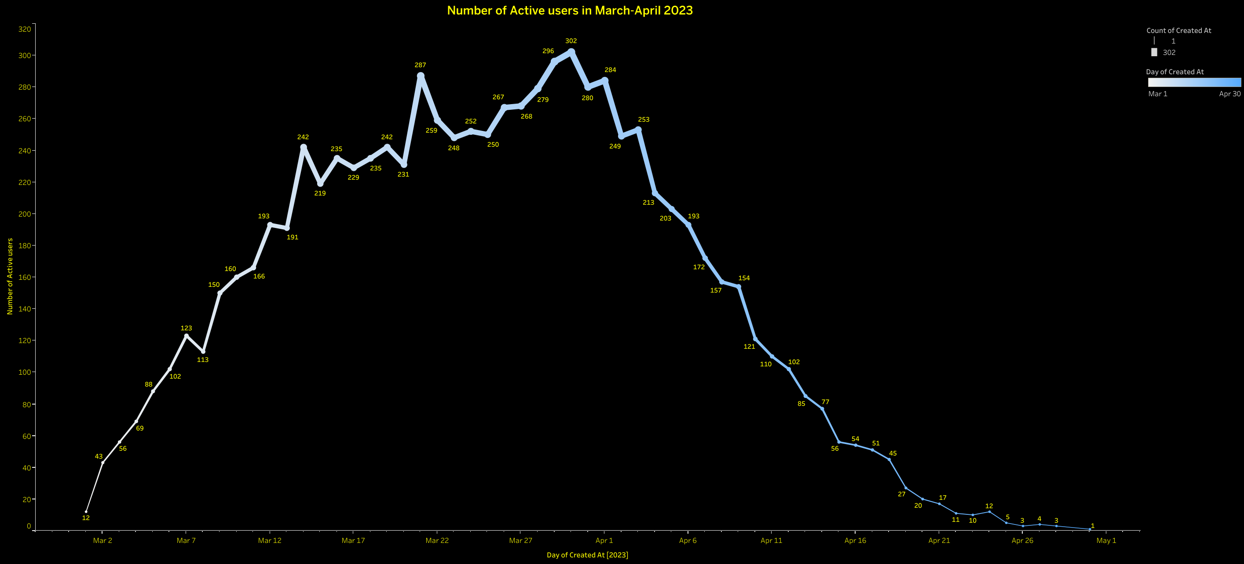
Website Engagement in March-April 2023

Slide 16
Website Engagement in March-April 2023
March's Arrival: As we embark on our data journey, the month of March greets us with a humble beginning. On the 1st of March, there were 12 visitors to the website, suggesting a gradual awakening.
Marching On: As the days of March unfold, we witness a consistent increase in website traffic. By March 11, the daily visitor count reaches 166, indicating a growing interest or relevance during this period.
Mid-March Dip: Around the middle of March, there's a noticeable dip in website visitors, with counts hovering between 191 and 193. This could be attributed to a temporary lull or a shift in focus during that time.
March's Grand Finale: The month of March bids farewell with 280 visitors on the 31st. It concludes with a sense of accomplishment, leaving us curious about what April has in store.
April's Entrance: April steps onto the stage with 284 visitors, almost mirroring March's end. It's as though the narrative continues seamlessly into the next month.
April's Undulations: April is marked by fluctuations in website traffic. The numbers sway between 157 and 302, painting a dynamic picture of engagement. Peaks and troughs reflect the changing interests of our online audience.
April's Reflection: Mid-April provides a moment of reflection, akin to a pause in the narrative. Visitor counts briefly dip to 203, prompting us to ponder the possible reasons behind this shift.
The Final Strokes: Our data story gracefully concludes on April 30, 2023, with a single visitor. It's akin to the final brushstroke on a canvas, suggesting that every story must eventually reach its conclusion.

Slide 17
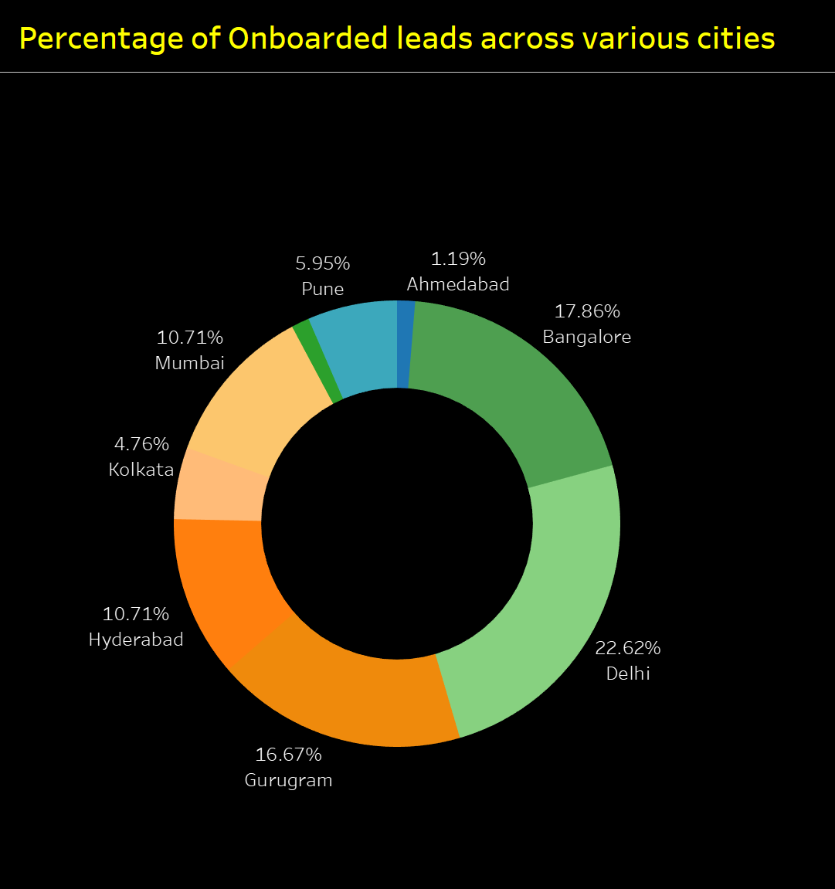
Percentage of Onboarded leads across various cities
Pune and Mumbai had 5 and 9 leads, respectively, making up 5.95% and 10.71% of the total.
Hyderabad gathered 9 leads, constituting around 10.71%.
Kolkata contributed 4 leads, representing approximately 4.76%.
Ahmedabad had 1 lead, accounting for roughly 1.19%.
Noida also had 1 lead, making up around 1.19%.
There were 7 leads with an unspecified city (n/a), representing 8.33% of the total.
Delhi had the highest number of leads with 19, representing approximately 22.62% of the total leads.
Gurugram was the second-highest contributor with 14 leads, making up around 16.67%.
Bangalore secured the third position with 15 leads, accounting for about 17.86%.

Slide 18

"In the world of business, data is not just information; it's the key to understanding, adapting, and thriving."
“
”

Slide 19





Recommendations
Prioritization of Hot Leads:
Implement a lead prioritization system to identify and prioritize hot leads based on their behavior and likelihood of conversion. Ensure these leads are contacted promptly.
Customer Care Training:
Provide additional training and resources to the customer care team to enhance their ability to identify and nurture potential conversions.
Lead Tracking:
Implement a robust lead tracking system to monitor lead follow-up activities and ensure timely contact.
Lead Source Optimization:
Focus marketing efforts on sources that yield higher conversion rates, as indicated by the data.
Feedback Loop:
Establish a feedback loop between the sales and marketing teams to improve lead quality and alignment.

Slide 20
Implementation and Monitoring
The recommendations were gradually implemented, with close monitoring of the lead conversion rate. The implementation phase involved:
Implementation
Training and development programs for the customer care team.
Deployment of lead tracking and prioritization tools.
Refinement of marketing strategies based on lead source performance.
Project Scope
Analysis of the entire lead acquisition process, from lead generation to conversion.
Focusing on the customer care team's interaction with leads.
Identifying bottlenecks and inefficiencies in lead follow-up procedures.
Proposing data-driven recommendations for improving the lead conversion rate.

Slide 21


Conclusion
This project focused on addressing SAPL's challenge of a low lead conversion rate. By analyzing the lead acquisition process, identifying bottlenecks, and implementing data-driven recommendations, SAPL will able to improve its lead conversion rate and capitalize on missed business opportunities. The successful implementation of these changes demonstrated the value of data-driven decision-making in optimizing business processes and achieving improved outcomes.
The pre-verification stage is essential for lead generation, with verification establishing trust and authenticity and high conversion rates. Improvements can be made in connection and agreement stages to optimize lead conversion.
Regional variations exist with Delhi, Bangalore, and Gurugram having strong conversion rates, and Chandigarh presenting untapped potential.
Lead trends and seasonal patterns suggest the need for strategic lead management and targeted marketing efforts.
Further analysis is needed to identify data anomalies and address any issues.

Slide 22

Thank you
Pintu kumar kushwaha
pkmansarowar@gmail.com
LinkedIn: @pintukushwaha

